Slide 1
Residual Analysis
Using Plots

Slide 2
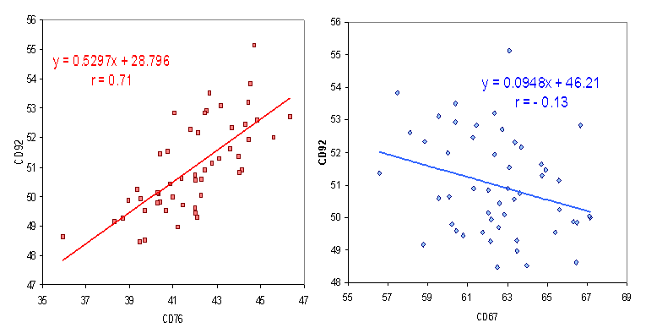
Scatterplots

Slide 3
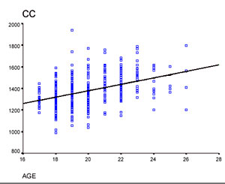
With categorical X

Slide 4
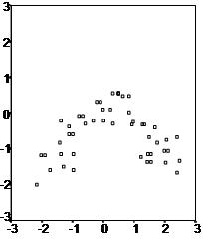
Not a linear relationship

Slide 5
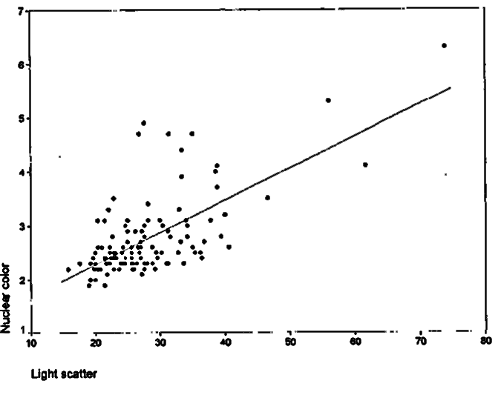
May need a transformation

Slide 6
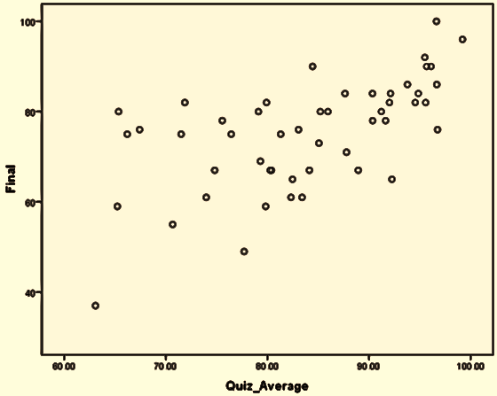
One outlier might change the relationship

Slide 7
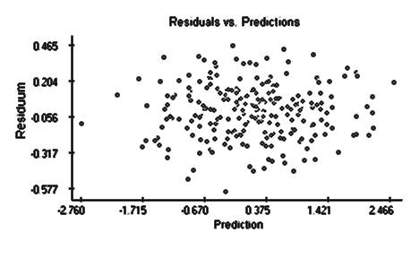
Residual Analysis – Good Residuals

Slide 8
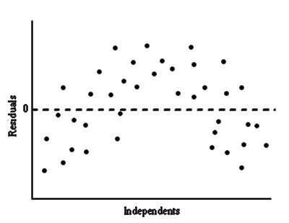
E vs X: check for Linearity
Non-linear – model may need quadratic term in X

Slide 9
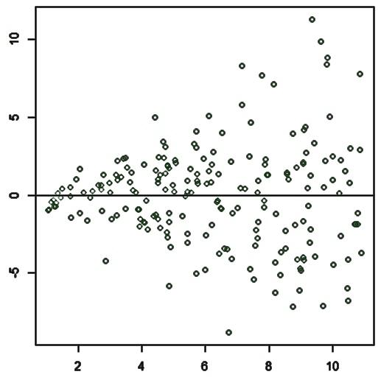

Test for Heteroscedasticity (same variance) e vs $\hat{Y}$
Variance is not constant

Slide 10
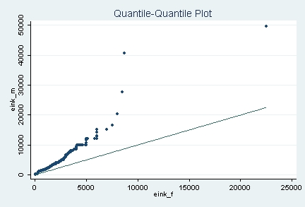
Check for normality qqplot of e
Clearly not normal

Slide 11
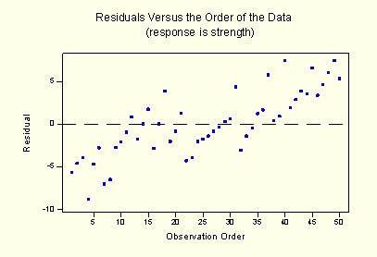
Checking for independence plot e vs order of run
Shows a trend

Slide 12
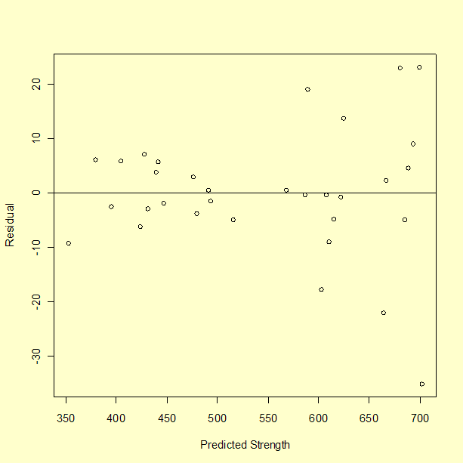
What do you see? Residuals vs Predicted

Slide 13
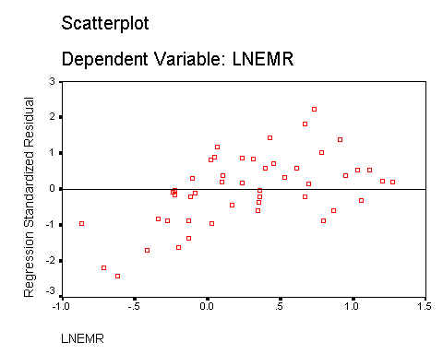
Residual vs X

Slide 14
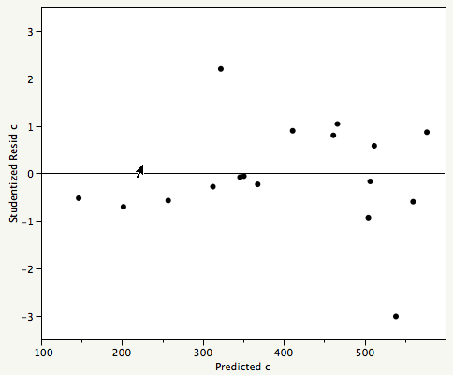
Residuals vs Predicted

Slide 15
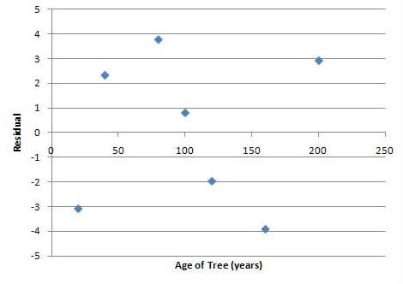
Residual vs X

Slide 16
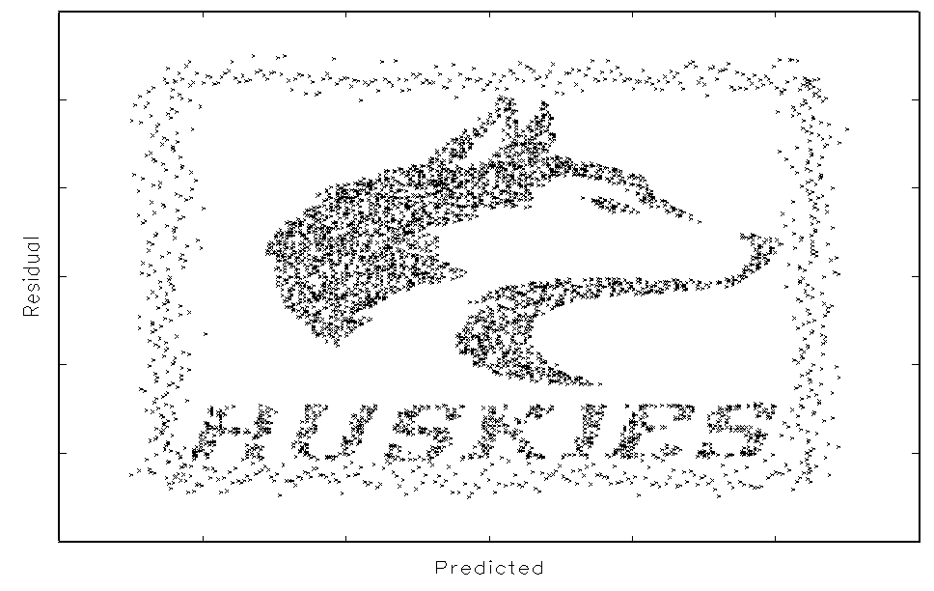
Residual vs Predicted

